Slide 1
Ranking Tasks: Position-Time Graphs

Slide 2
Rank the following from least to greatest velocity:
A ▲
B ▼
C ♦
D ■
On a scale of 0-10, how confident are you?
(0=guessed, 10=100% confident)

Slide 3
Rank the following from least to greatest velocity:
A ▲
B ▼
C ♦
D ■
On a scale of 0-10, how confident are you?
(0=guessed, 10=100% confident)

Slide 4
Rank the following from least to greatest velocity:
A ▲
B ▼
C ♦
D ■
On a scale of 0-10, how confident are you?
(0=guessed, 10=100% confident)

Slide 5
Rank the following from least to greatest velocity:
A ▲
B ▼
C ♦
D ■
On a scale of 0-10, how confident are you?
(0=guessed, 10=100% confident)

Slide 6
Four friends are running a 20-meter race. Write a story that explains what happened, according to the graph.
Joe ▲
Murr ▼
Sal ♦
Q ■
On a scale of 0-10, how confident are you?
(0=guessed, 10=100% confident)

Slide 7
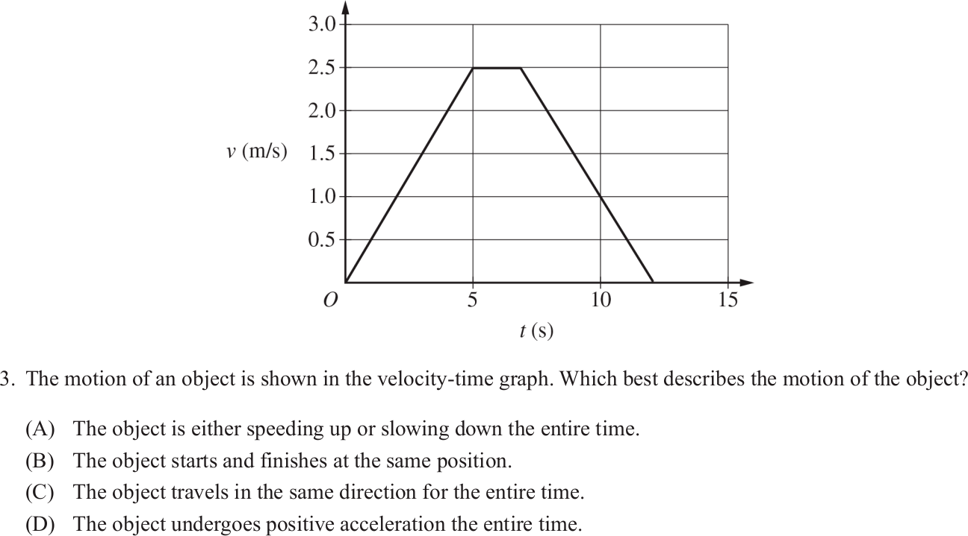

Slide 8
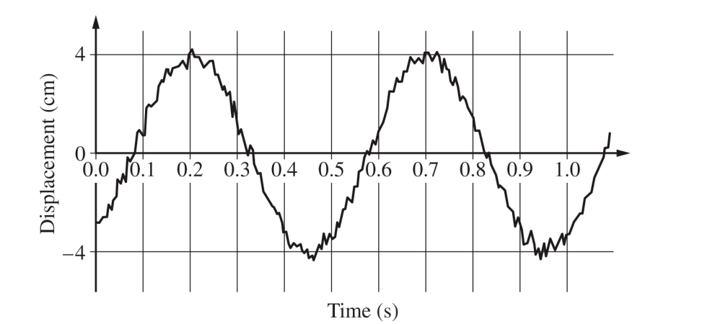
Explain how to calculate the speed at 0.65 seconds?

